Slide 1
Hypertrophic Cardiomyopathy in Sarcomere Variant Carriers and Non-Carriers Comparing the clinical course of disease
Christoffer Rasmus Vissing
SHaRe investigator meeting
9 May 2023

Slide 2
Hypertrophic cardiomyopathy

Slide 3
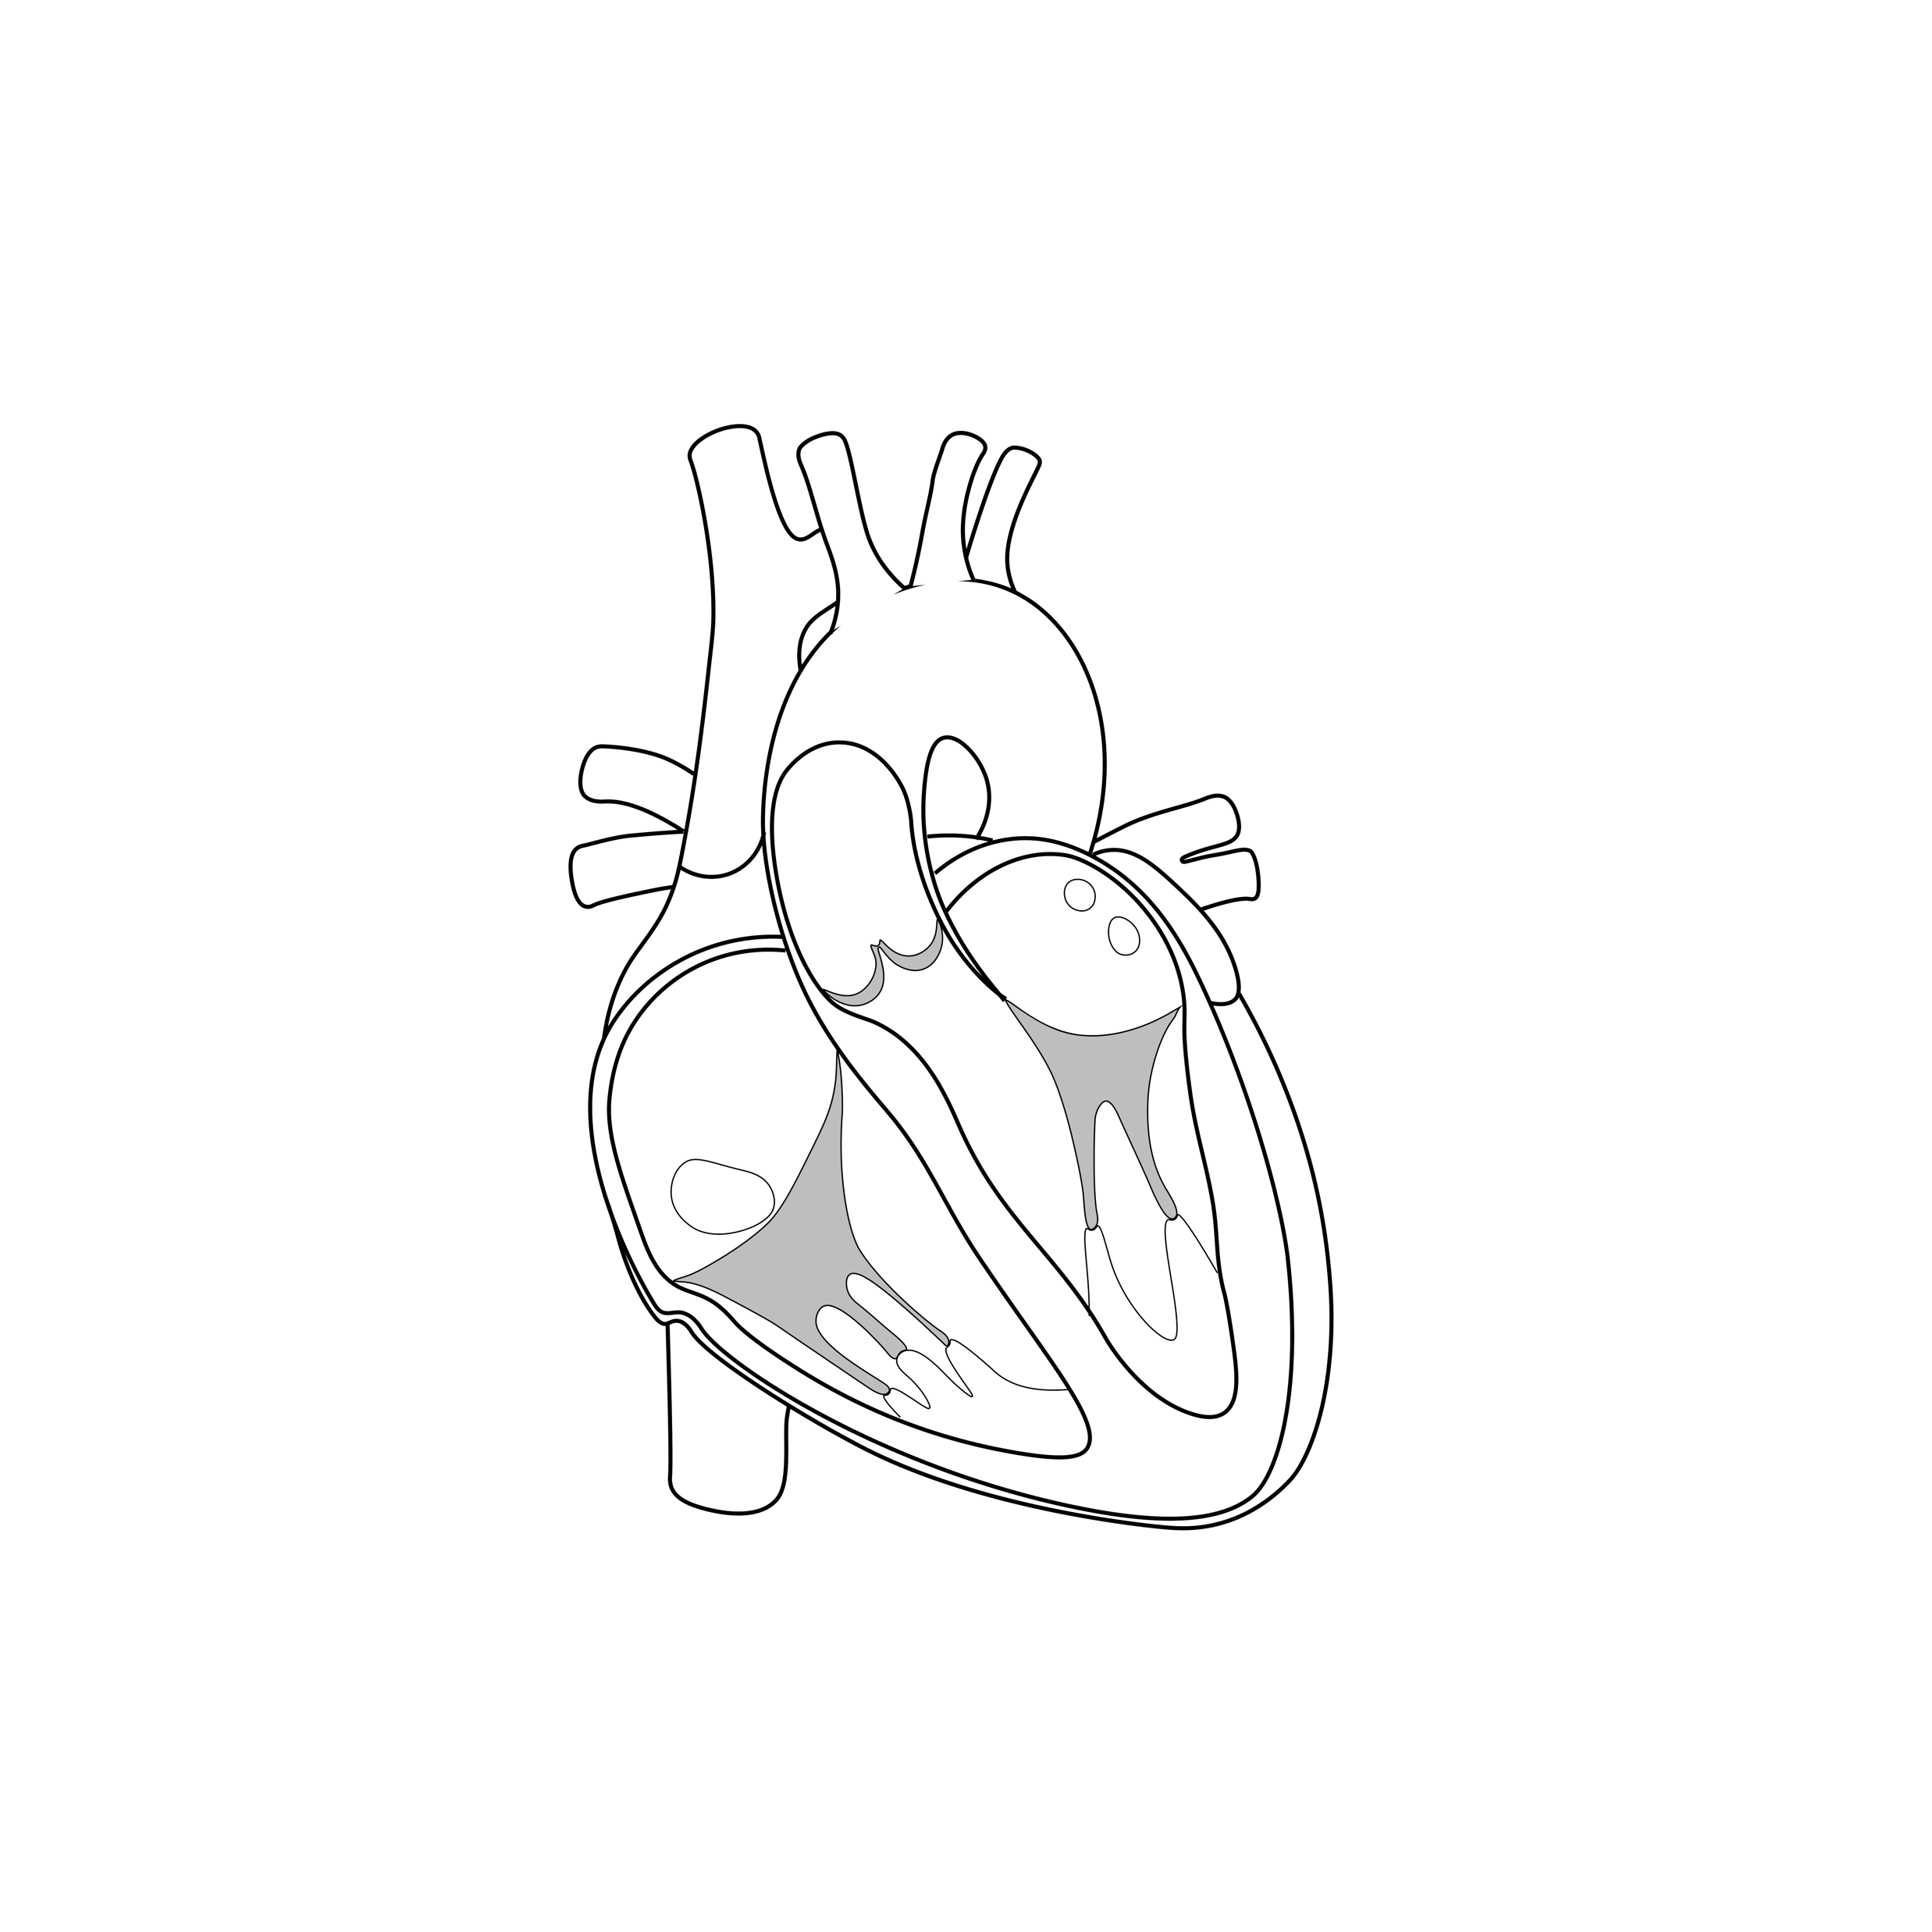
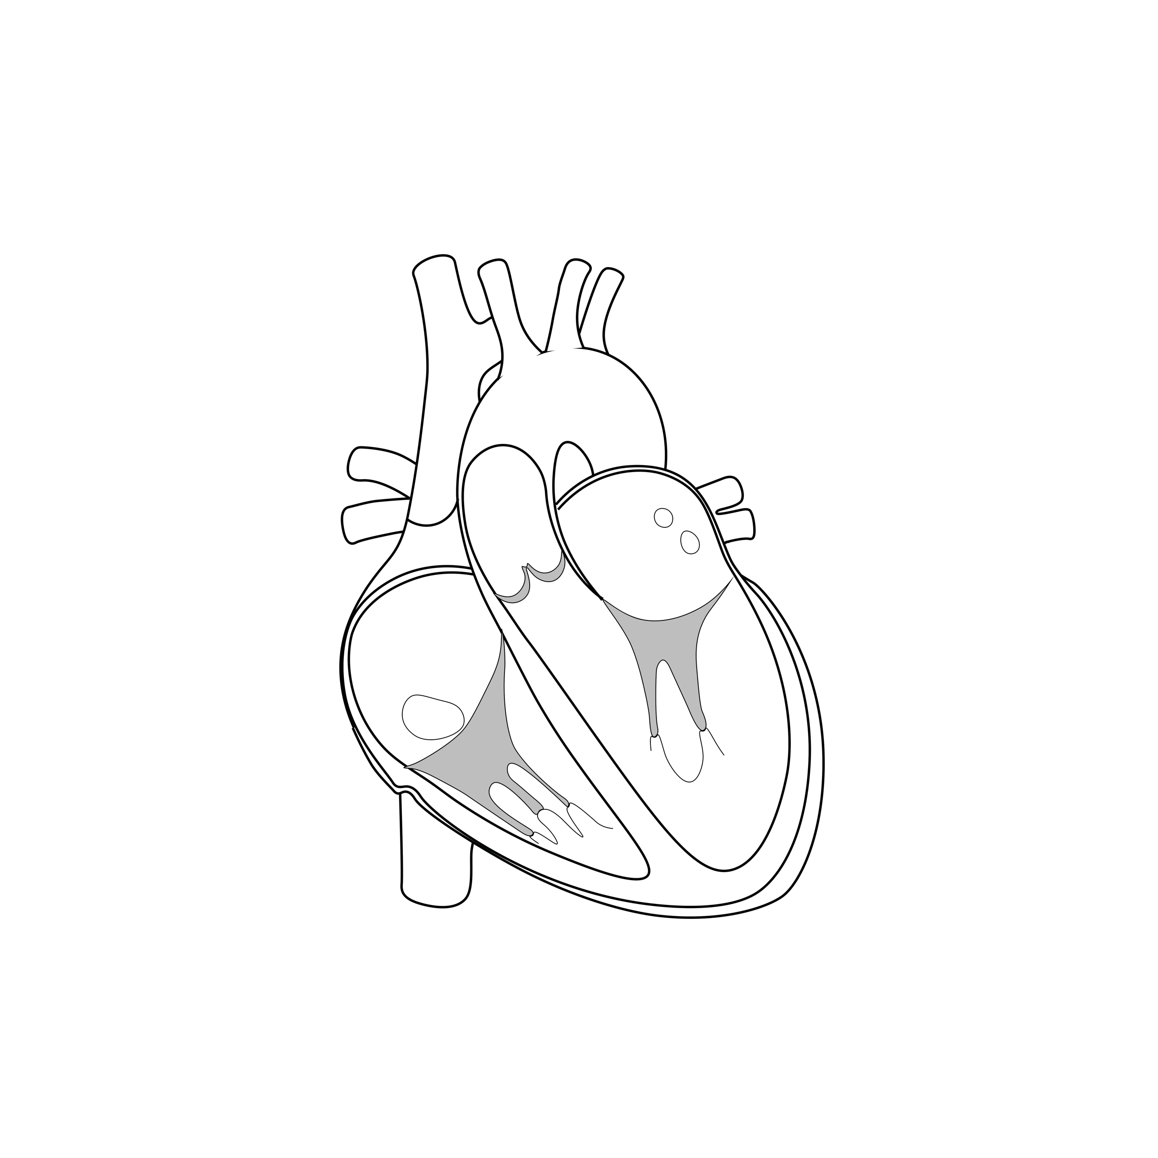
Natural history of disease
Heart failure
Arrhythmias
Normal heart
Presymptomatic
Cardiomyopathy
Premature
Death
LA dilation or other subtle abnormalities
Significant LVH
Genetic and/or
environmental vulnerability
Toxic affection

Slide 4
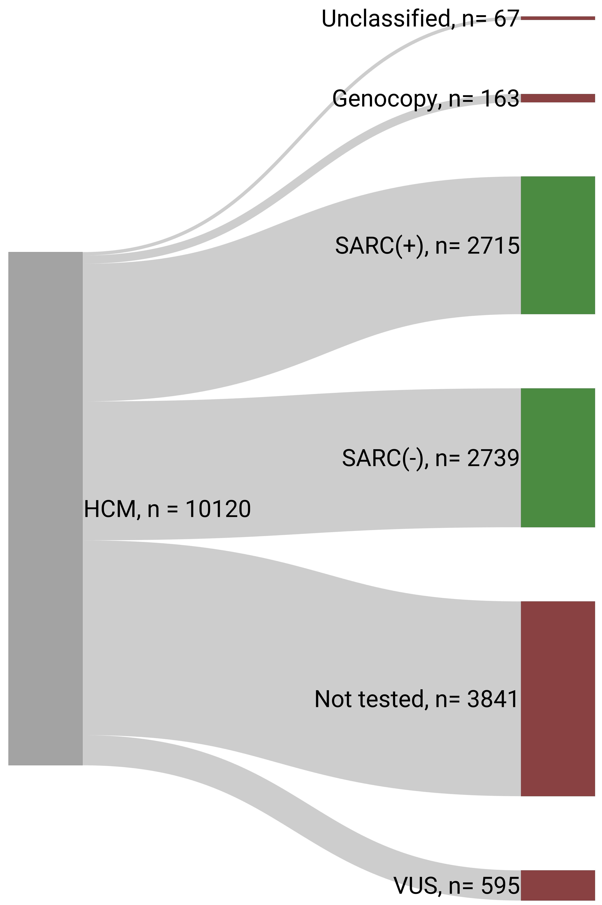
Study Cohort

Slide 5
Clinical characteristics

Slide 6
Clinical characteristics

Slide 7
LV obstruction

Slide 8
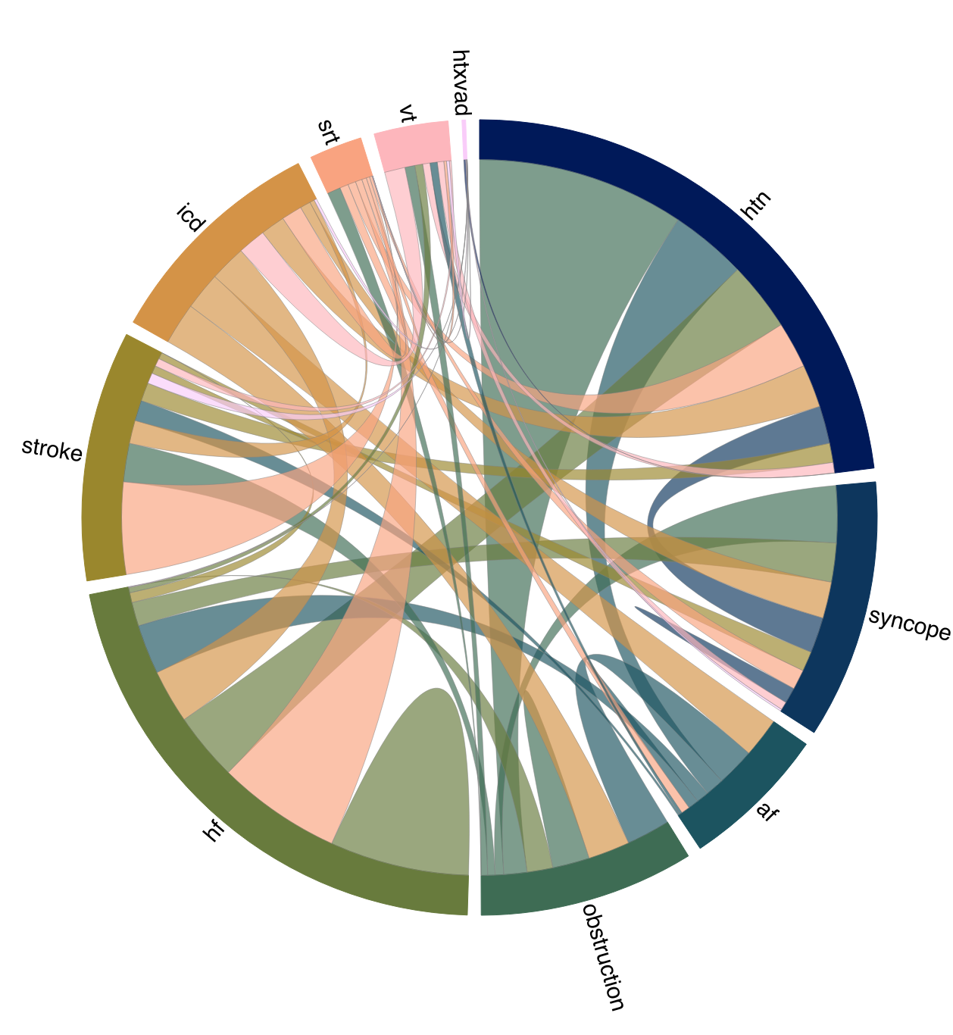
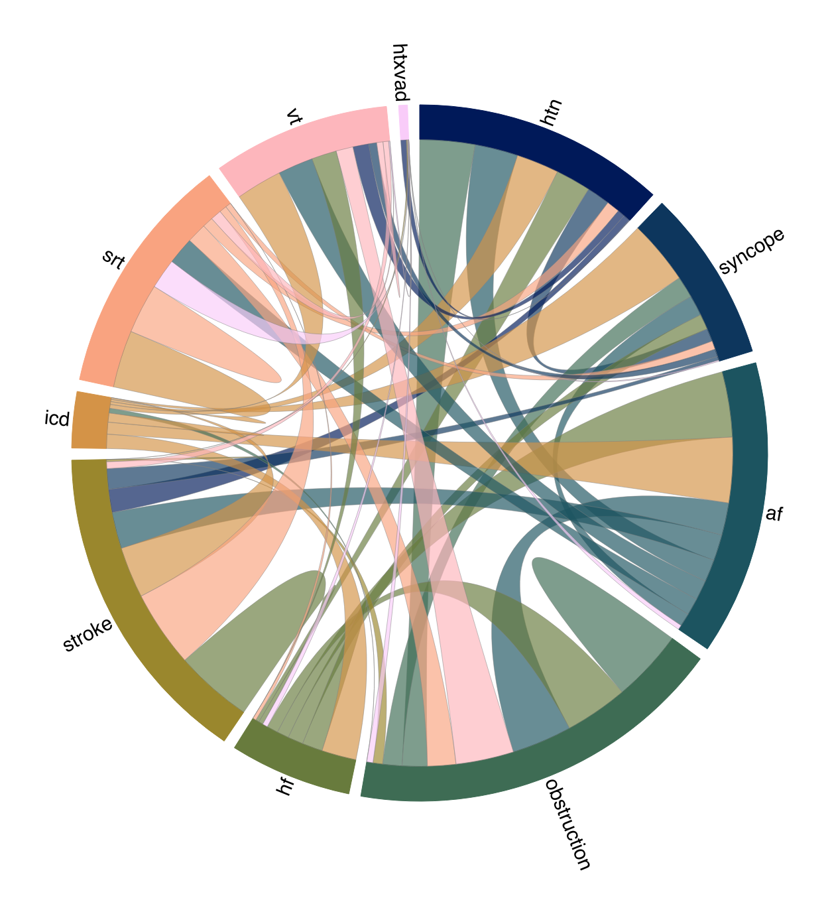

Slide 9
Atrial fibrillation

Slide 10
Ventricular tachycardia

Slide 11
LV systolic dysfunction

Slide 12
Cardiac transplantation

Slide 18
Relative timing of events

Slide 19
Timing of events

Slide 21
Common feature triplets

Slide 22
Common pairs (supp)

Slide 25
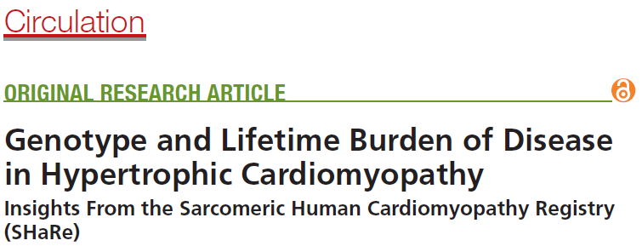
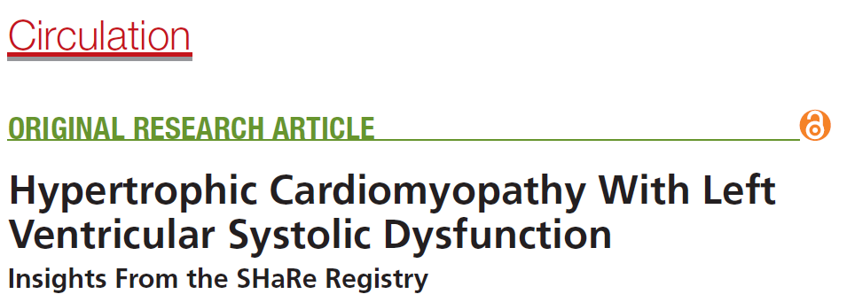
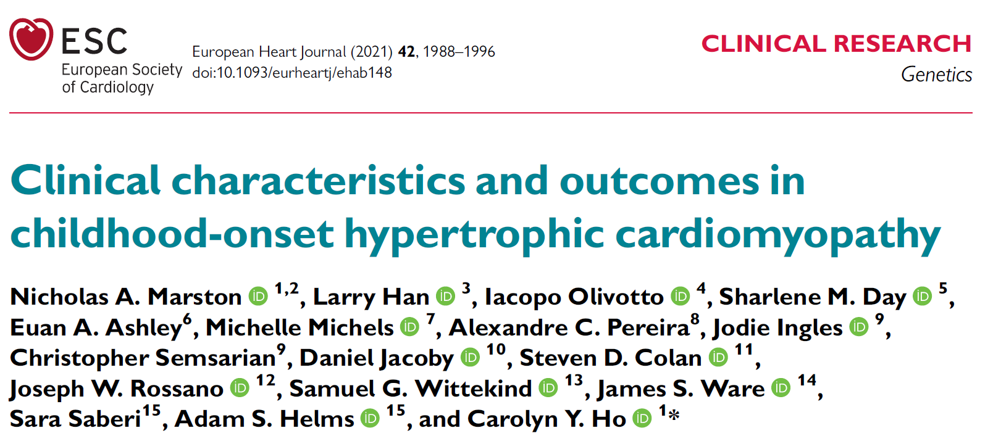
Short background

Slide 26


Timing

Slide 27
Agenda
Characteristics of study population
LVSD in childhood HCM
Childhood HCM vs adult-onset HCM
Outcomes
Subgroup in SHaRe
Age distribution
Baseline information

Slide 28
SHaRe
SHaRe dataset updated June 7th 2022
>17.000 subjects
Subgroup with childhood-onset HCM were included
Characteristics of study population

Slide 29
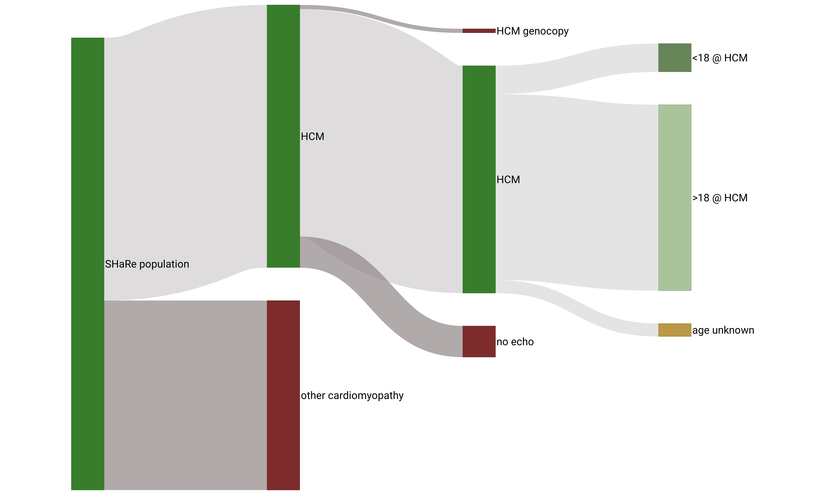
SHaRe - cohort
n= 1.104
n= 10.225
n= 8.848
n= 7.236
n= 17.060
Characteristics of study population

Slide 30
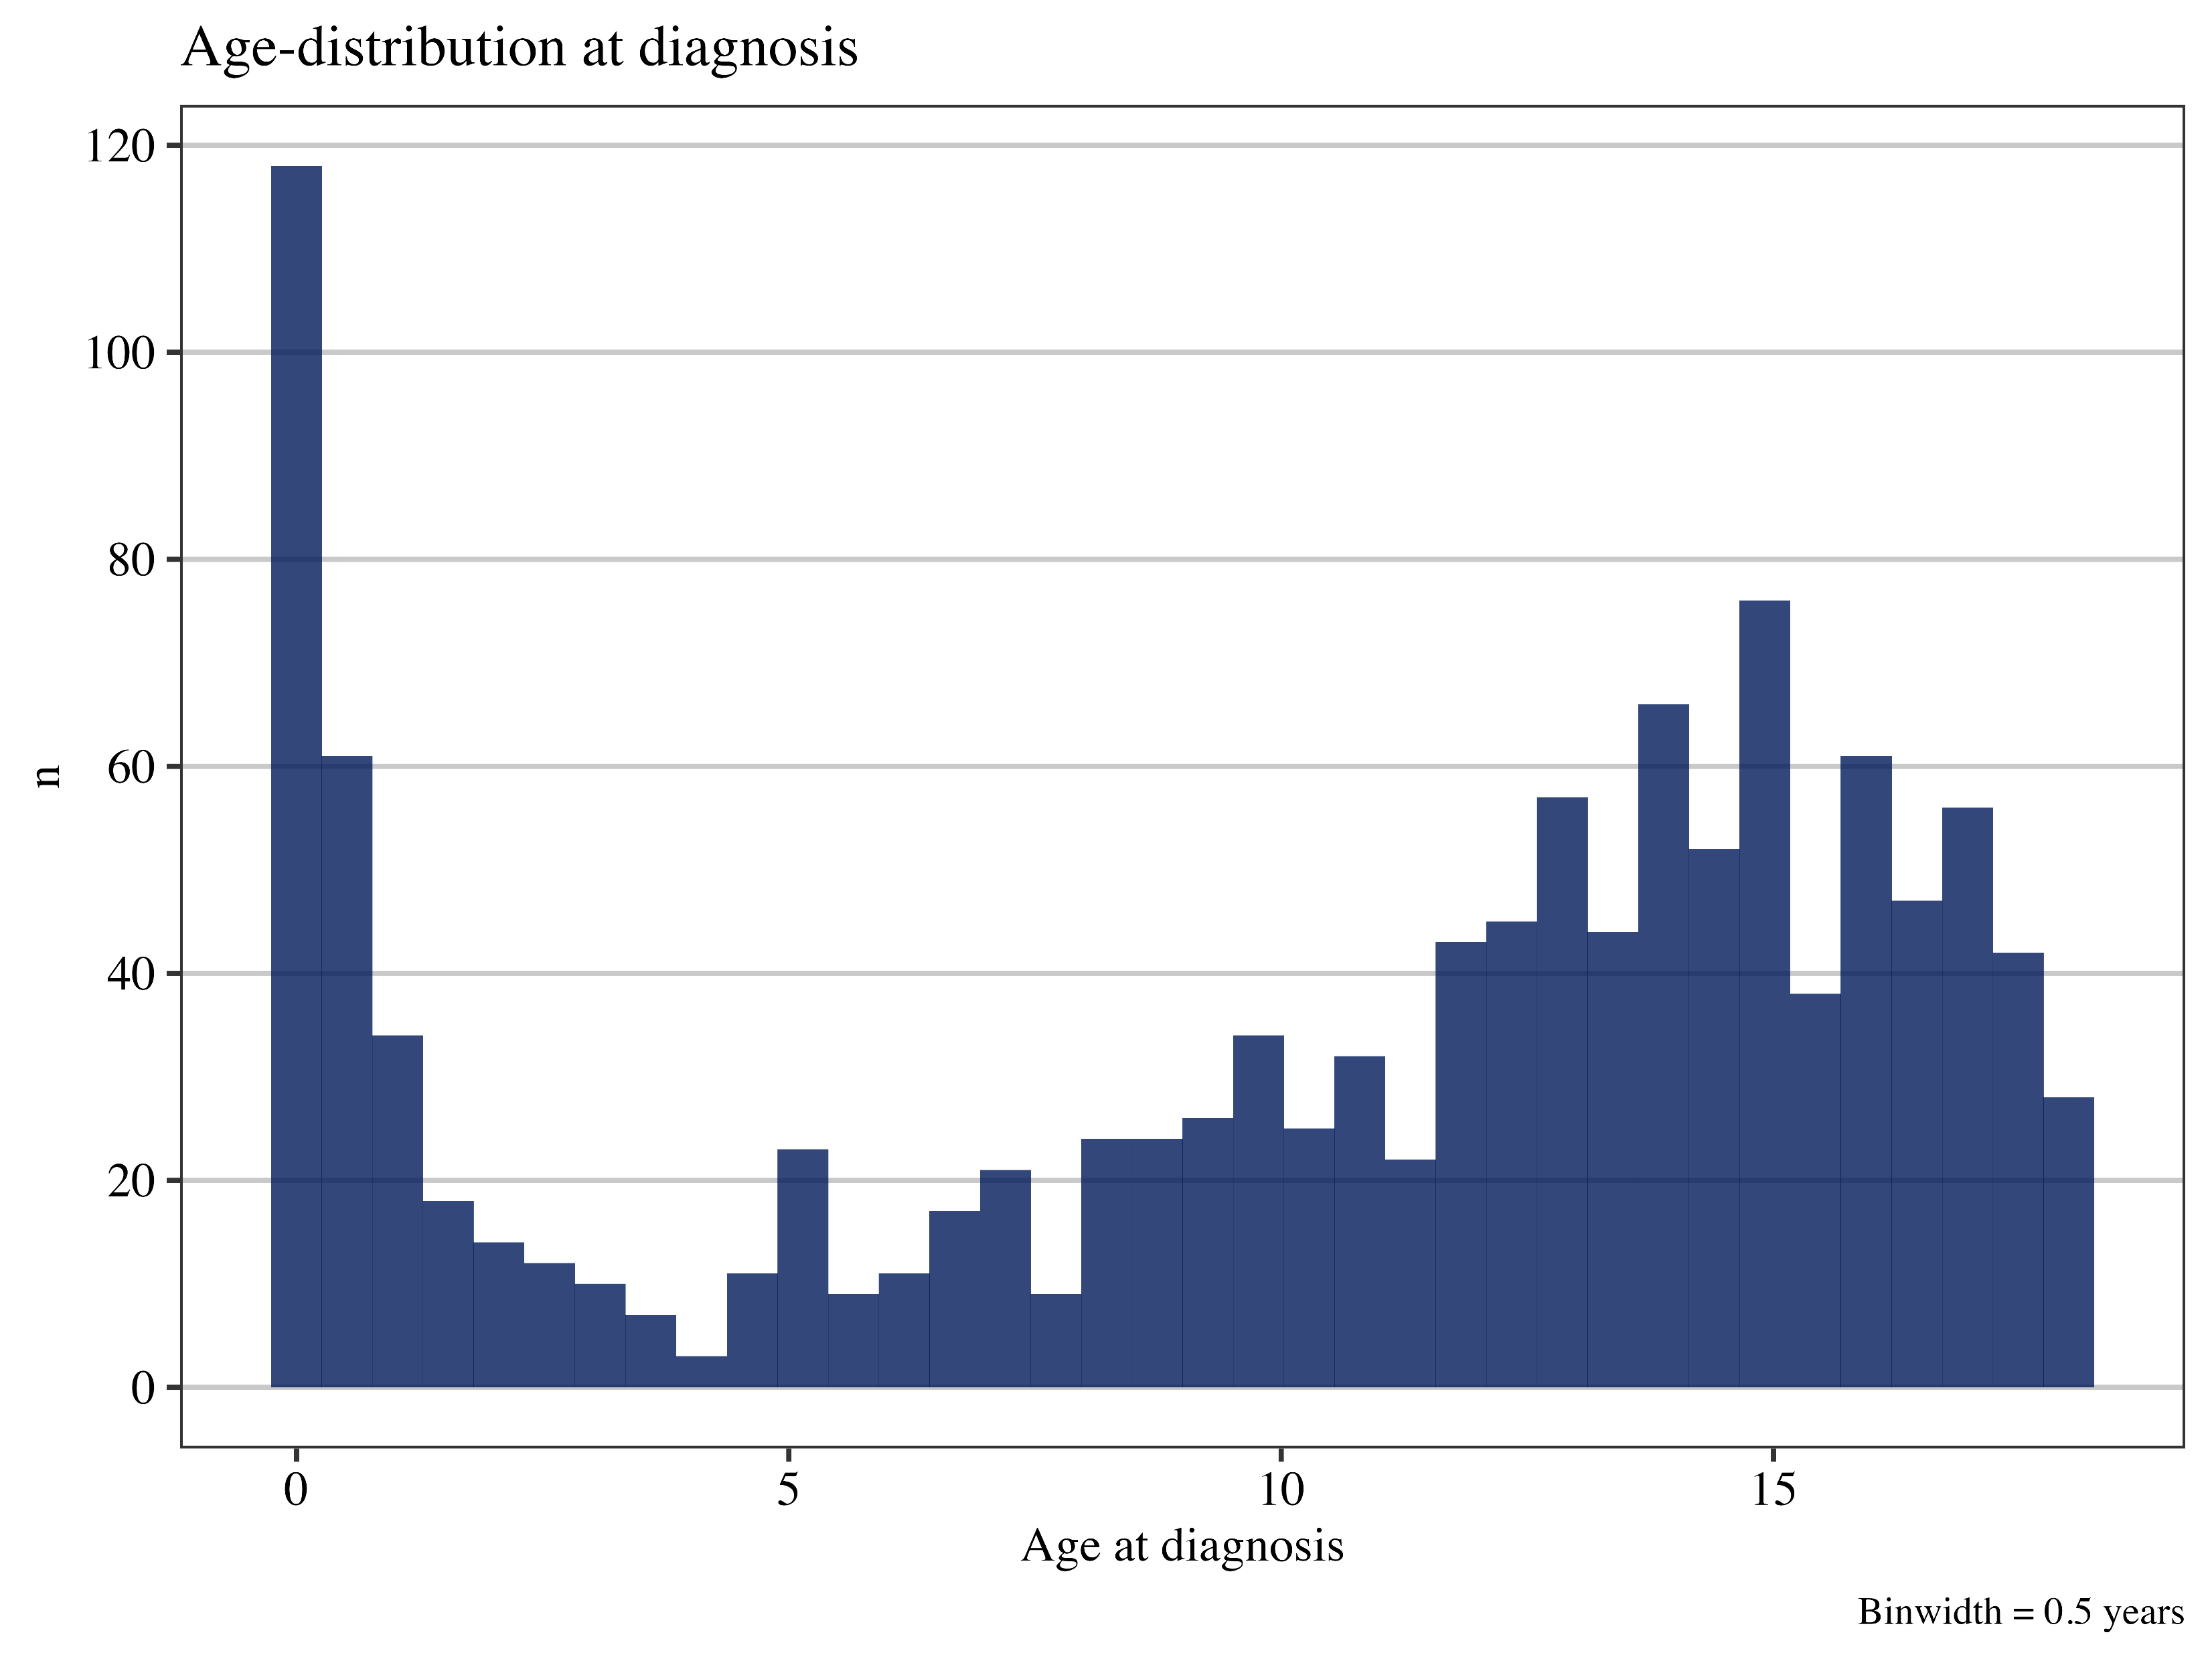
Age at HCM onset
Characteristics of study population

Slide 31
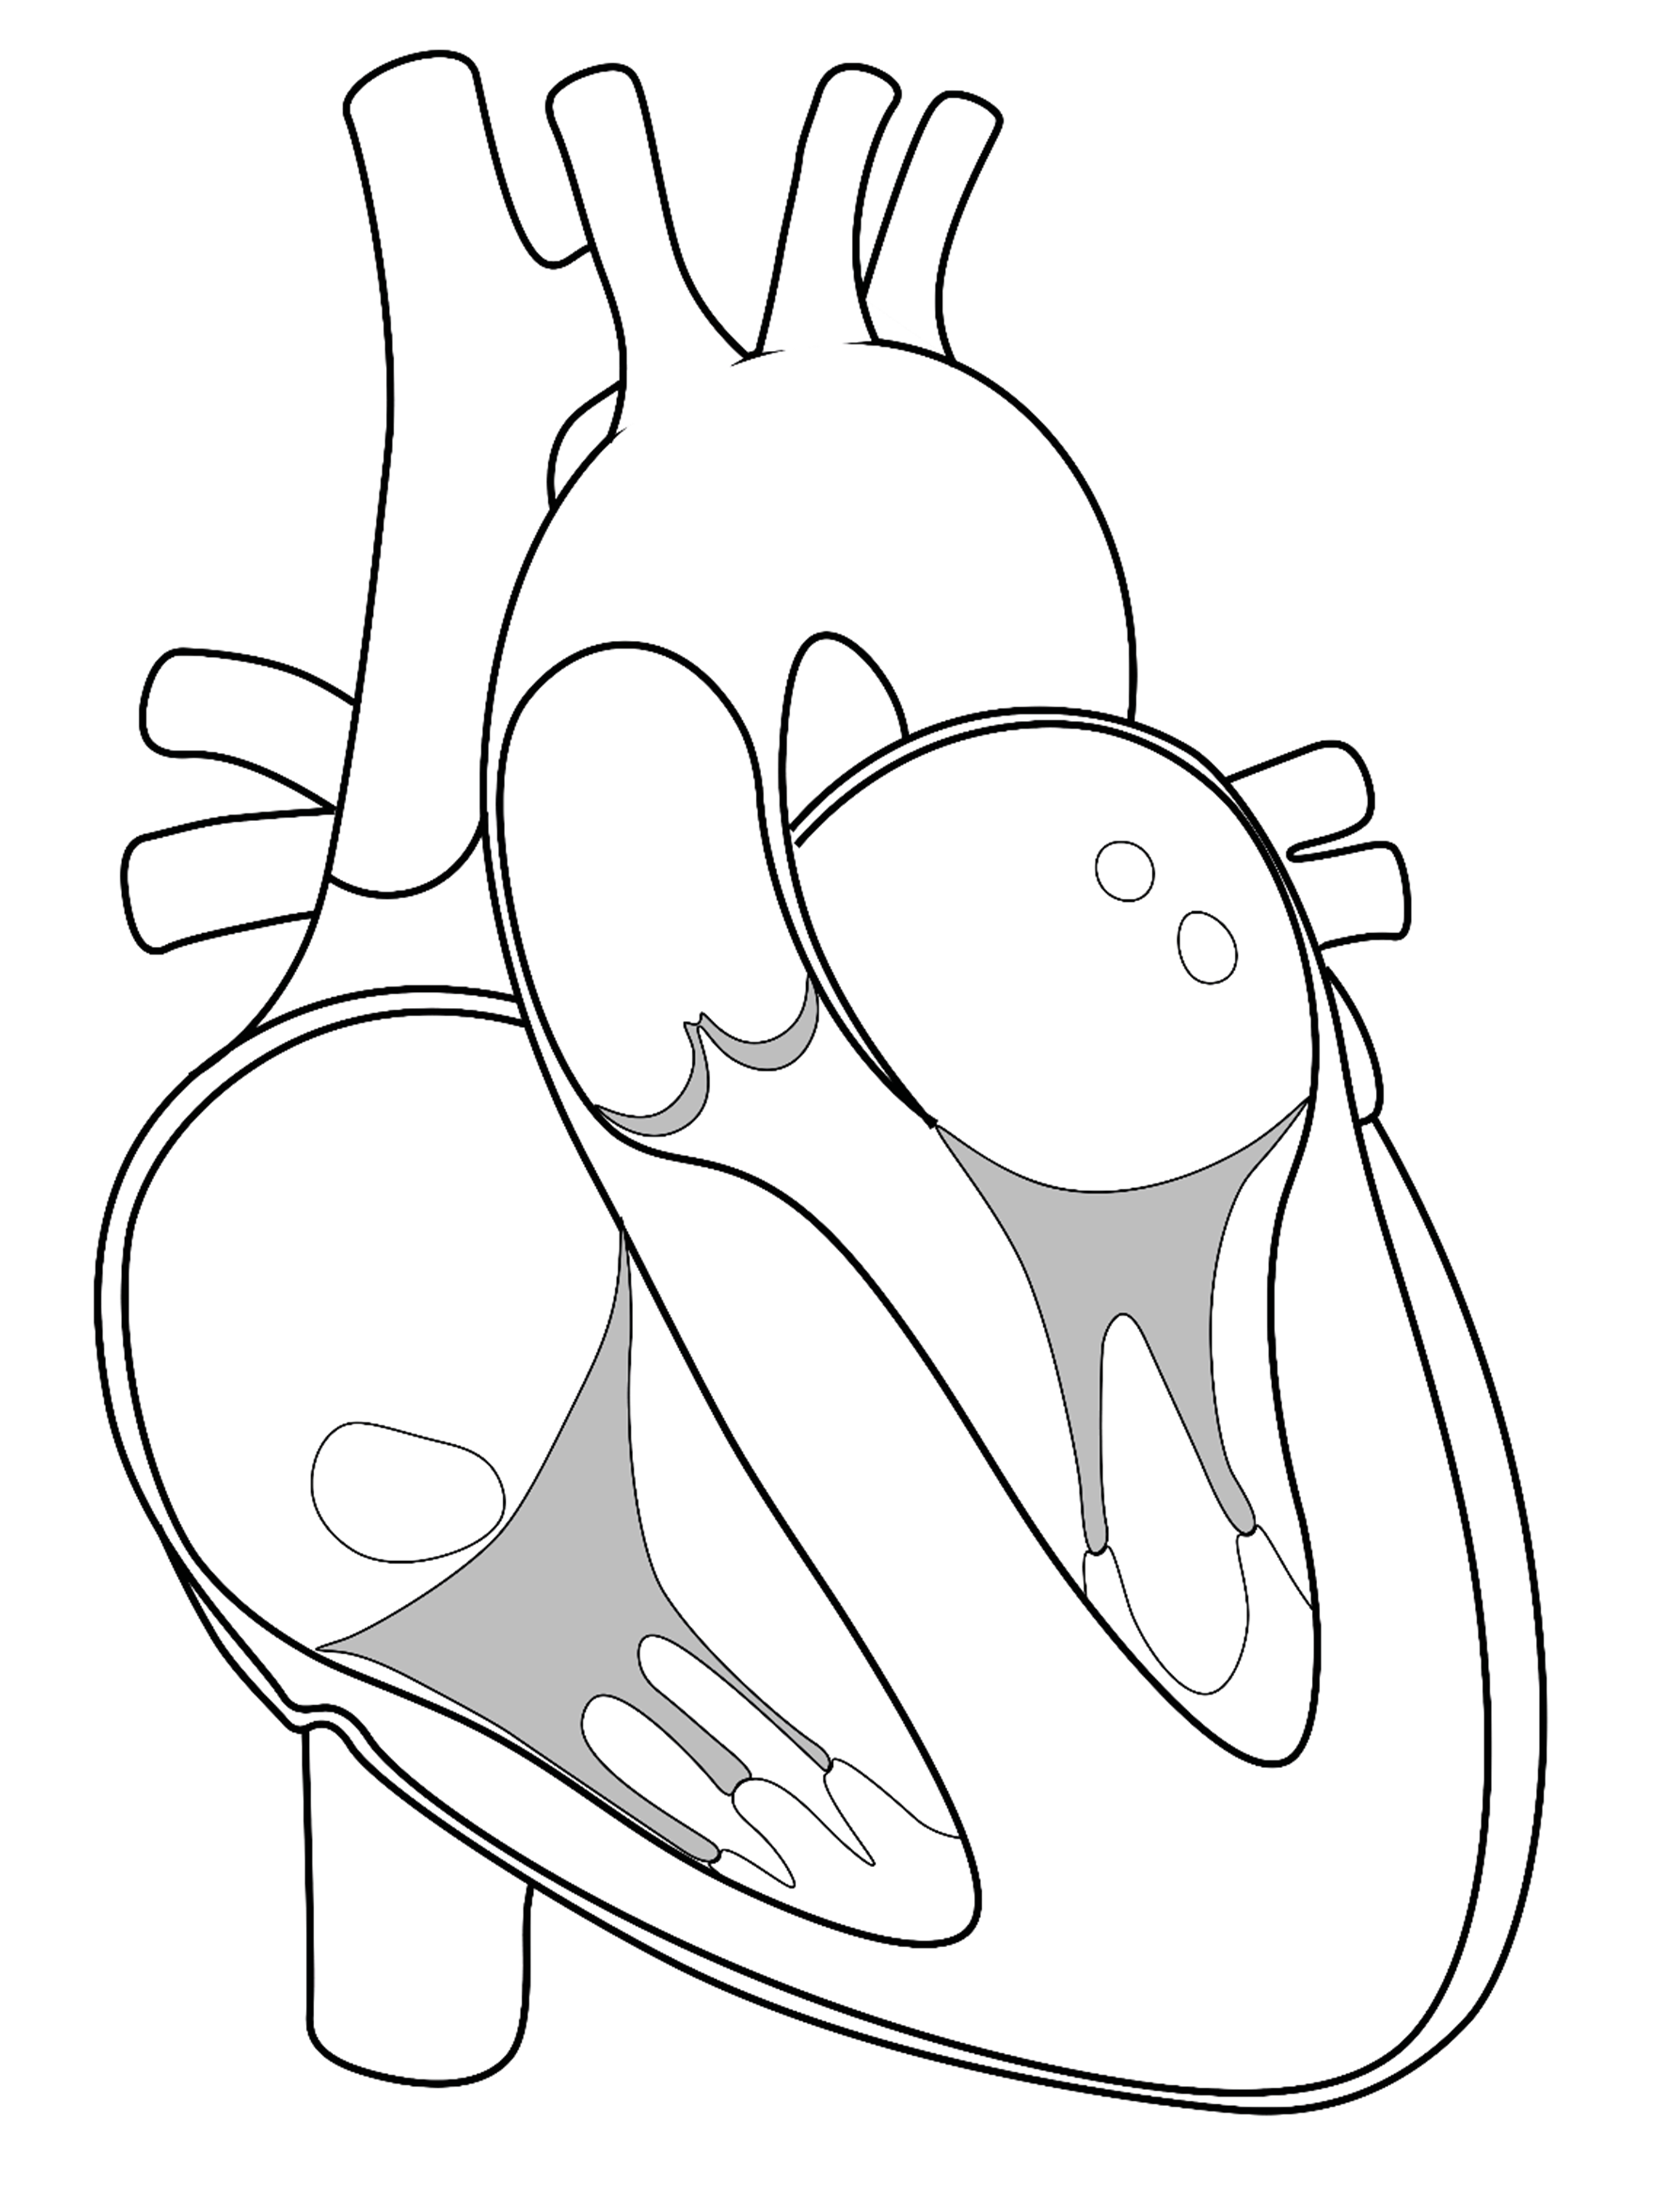
Overall prevalence of 13%
Follow-up
5 years (IQR: 2 to 9.6)
Pediatric-onset HCM
n = 1104 (36% female, 88% probands)
Age at HCM 12.6 (7.3 to 15.3)
LP/P variants in 63%
LVSD at first SHaRe visit in 6.4%
Characteristics of study population
LVSD in childhood HCM

Slide 32
Characteristics of study population
LVSD in childhood HCM
Childhood HCM vs adult-onset HCM
Outcomes
Incidence of LVSD
Factors predicting LVSD
Lowest LVEF in SHaRe

Slide 33
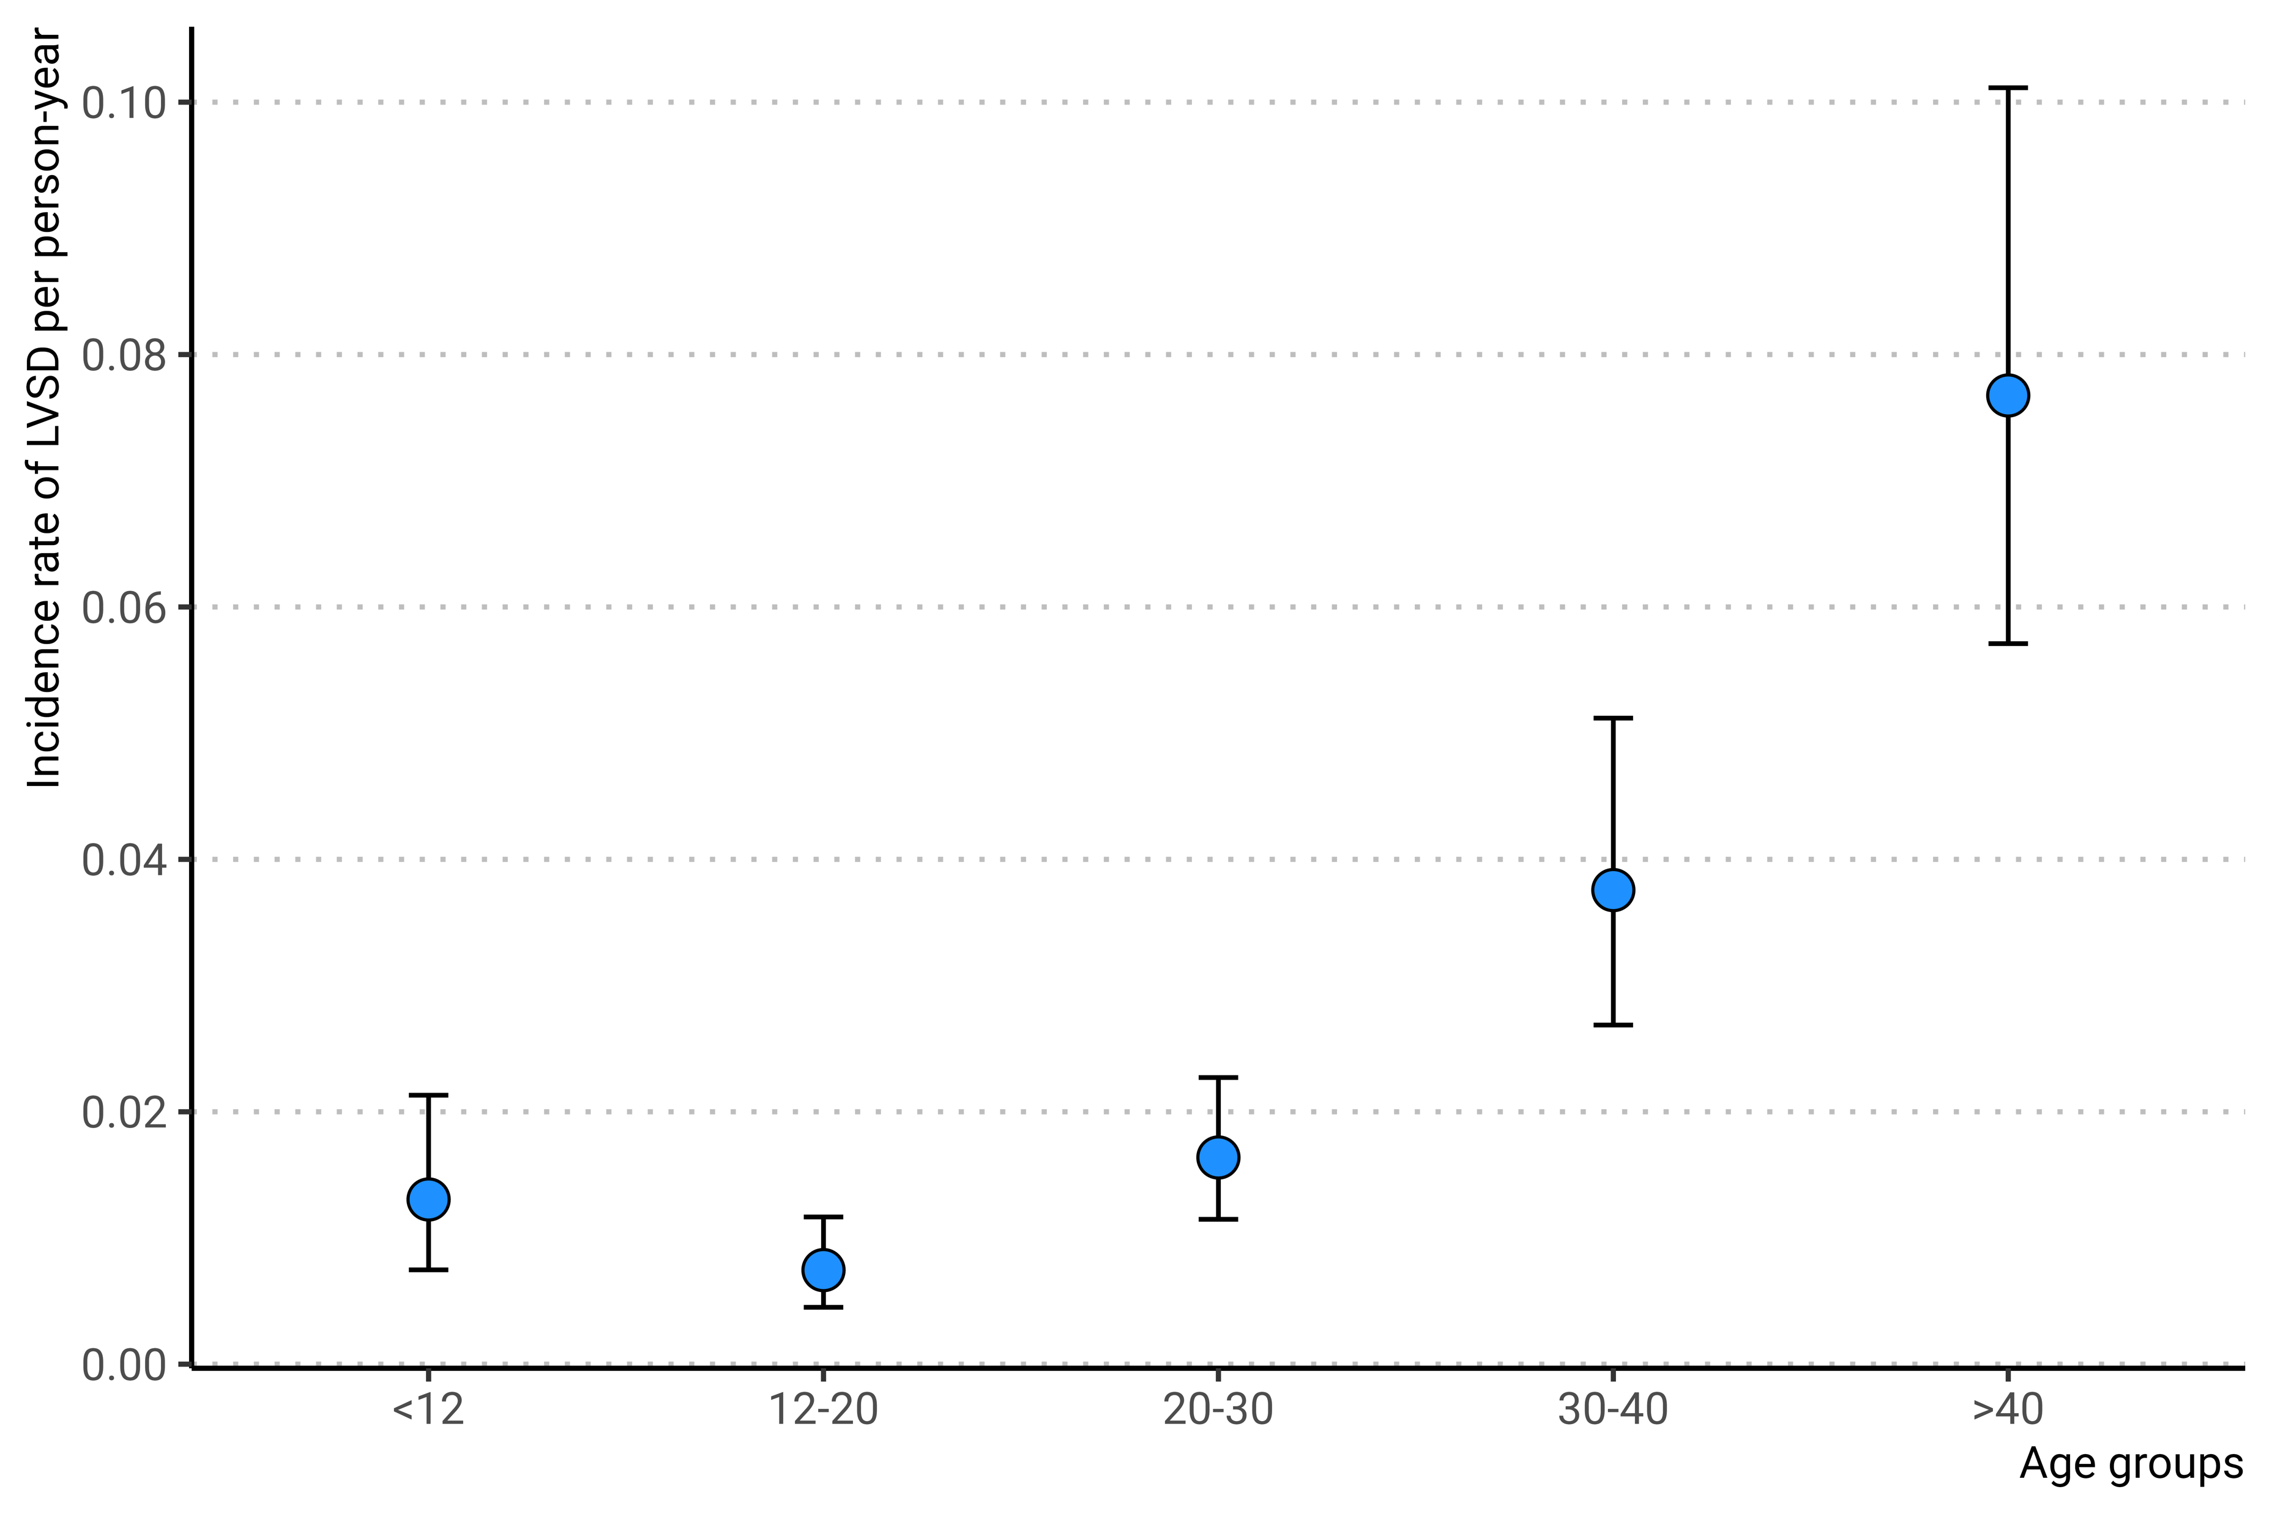
Incidence of LVSD in childhood HCM
Total follow-up:
6966 person-years
Overall incidence
2.1% per person-year
Characteristics of study population
LVSD in childhood HCM

Slide 34
Variables associated with LVSD
LVSD in childhood HCM

Slide 35
Lowest recorded LVEF in SHaRe
LVSD in childhood HCM

Slide 36
Characteristics of study population
LVSD in childhood HCM
Childhood HCM vs adult-onset HCM
Outcomes
Baseline differences
Genetic etiology of HCM
Cumulative incidence

Slide 37
Childhood HCM vs adult onset HCM
Characteristic | <18, N = 1,104¹ | 18+, N = 7,236¹ | p-value²
Female sex | 393 (36%) | 2,894 (40%) | 0.005
Age at HCM diagnosis, yrs | 12.6 (7.3 to 15.3) | 49.6 (37.3 to 60.6) | <0.001
LVSD at first SHaRe visit | 65 (6.4%) | 241 (3.6%) | <0.001
Total follow-up, yrs | 5.1 (2.0 to 9.6) | 4.3 (1.3 to 9.0) | <0.001
Proband | 968 (88%) | 6,475 (91%) | 0.006
Genetic status |  |  | <0.001
LP/P | 451 (64%) | 2,154 (44%)
VUS | 87 (12%) | 481 (9.8%)
Genonegative | 172 (24%) | 2,260 (46%)
Unknown | 394 | 2,341
Max LV wall thickness, mm | 16.0 (12.0 to 23.0) | 17.0 (14.0 to 21.0) | <0.001
LV ejection fraction at first echocardiography, % | 64.9 ± 10.8 | 65.0 ± 9.0 | 0.2
Left ventricular outflow tract obstruction, (lvot gradient >30 mmHg) | 151 (25%) | 2,434 (41%) | <0.001
Unknown | 491 | 1,233
Childhood HCM vs adult-onset HCM

Slide 38
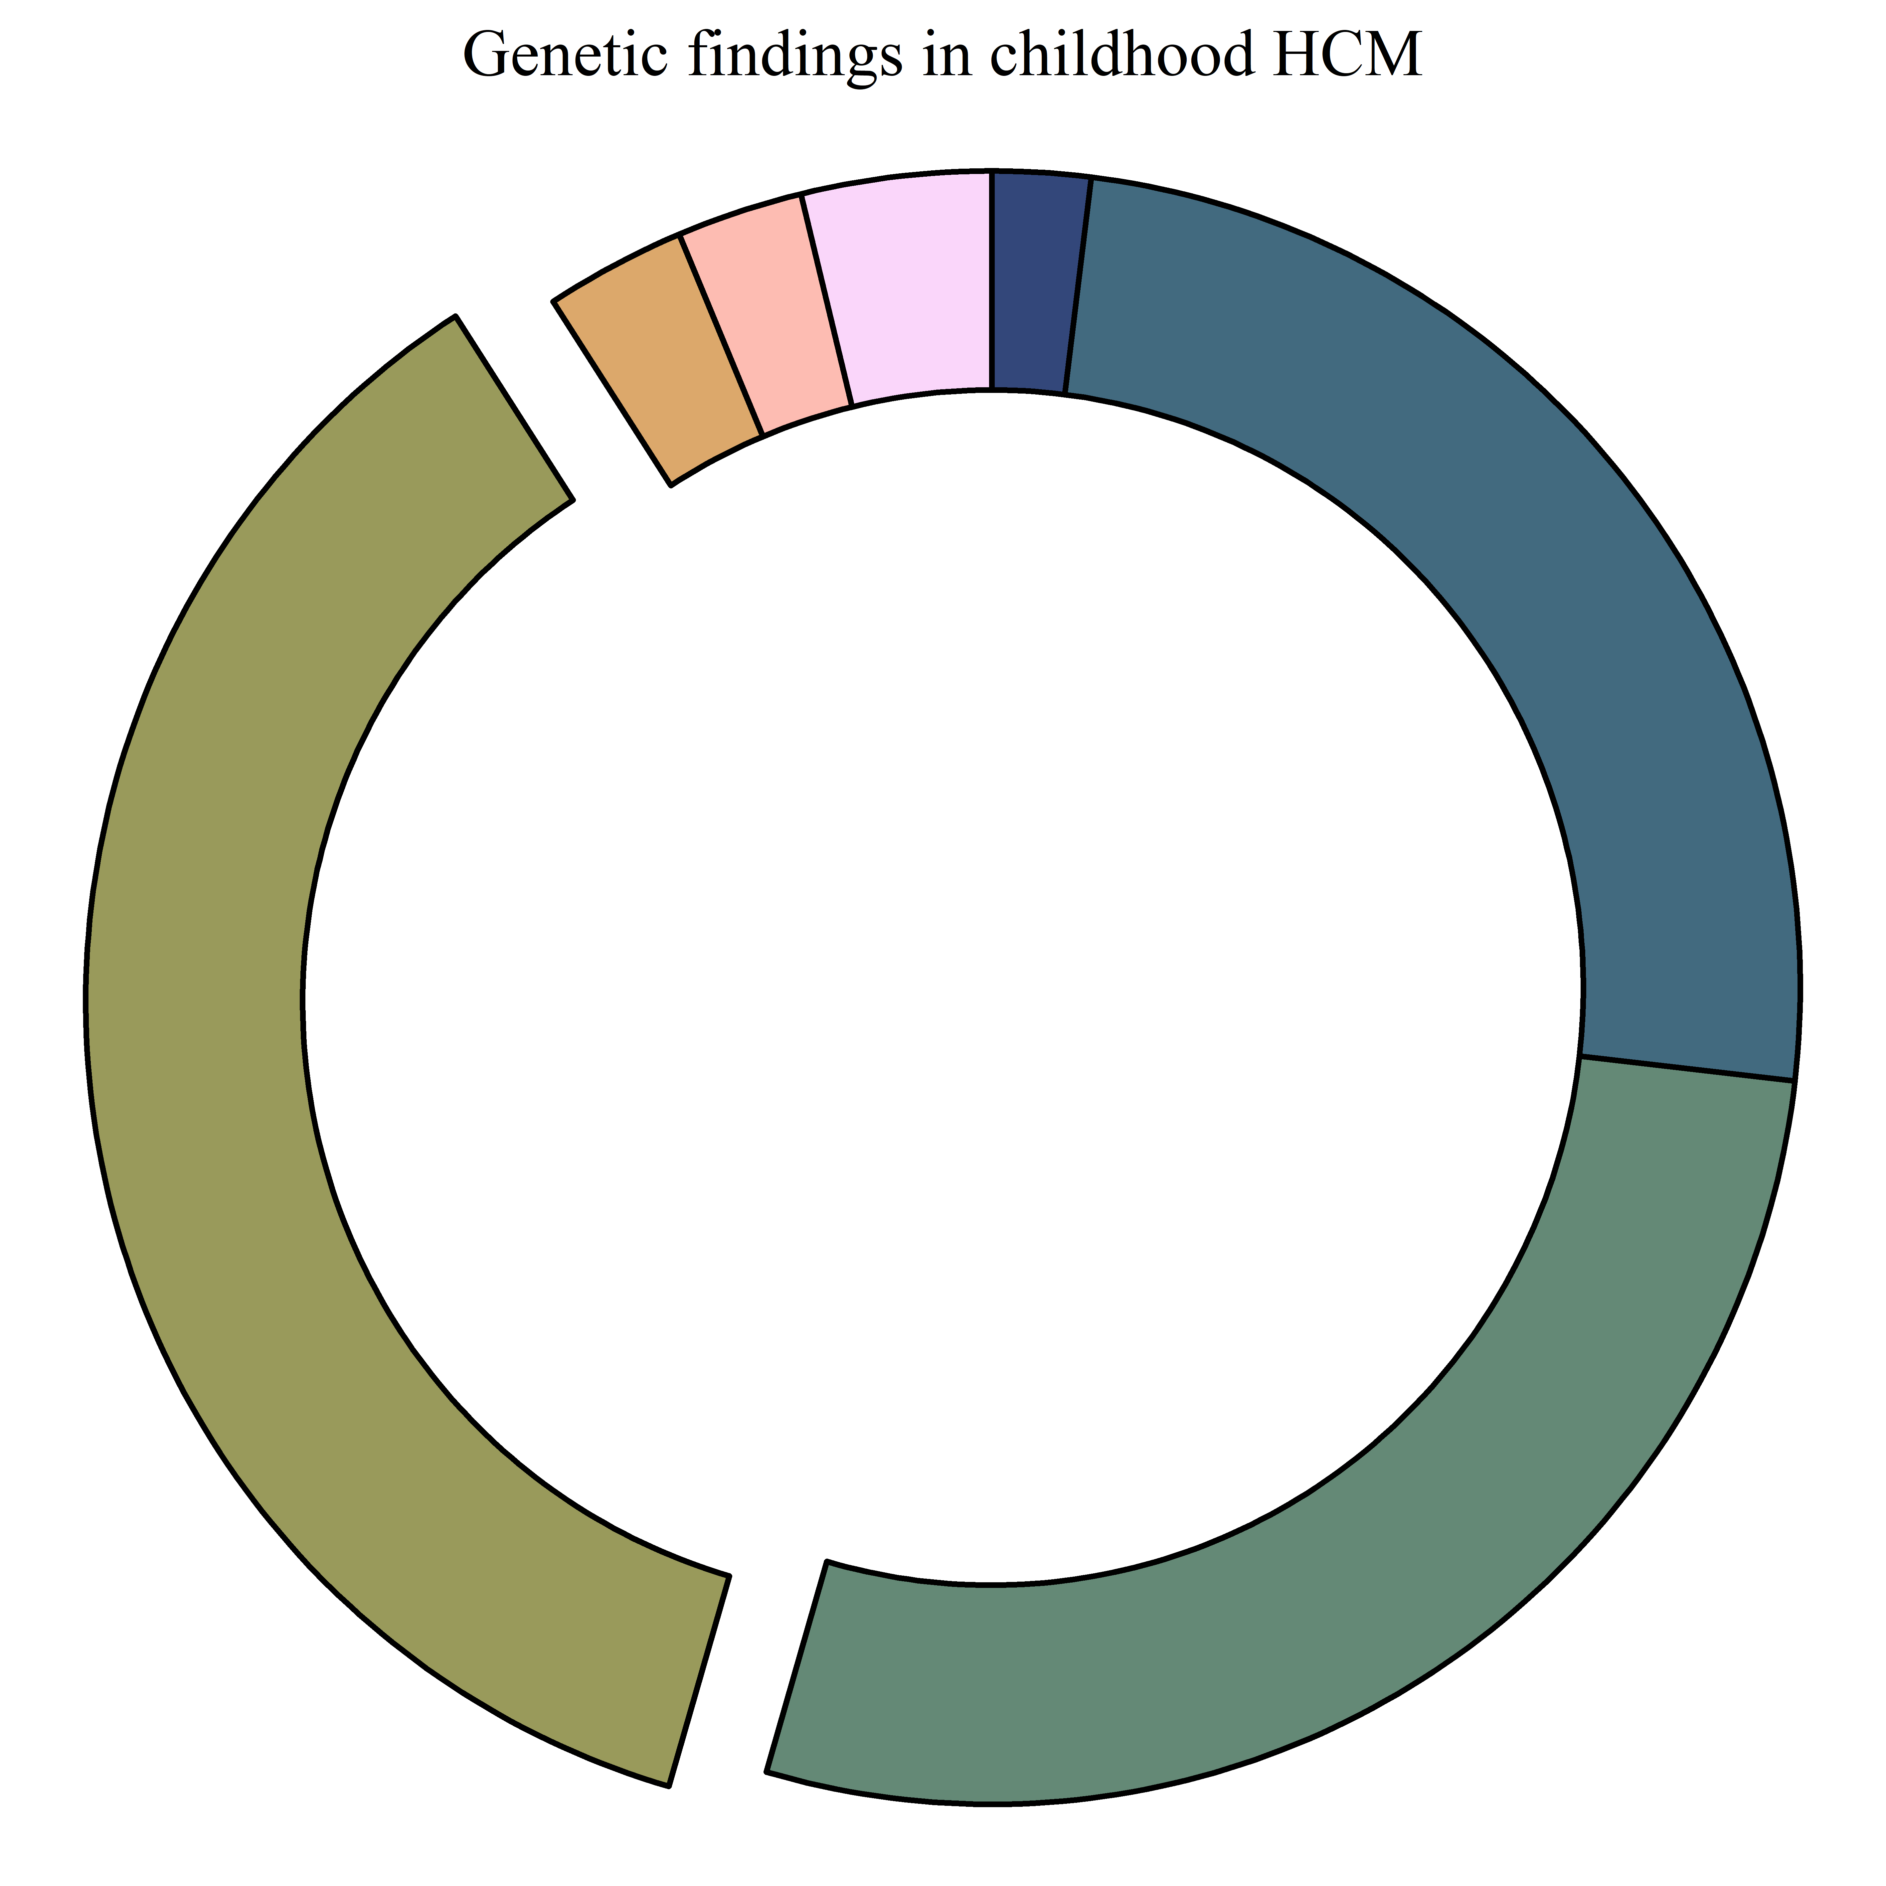
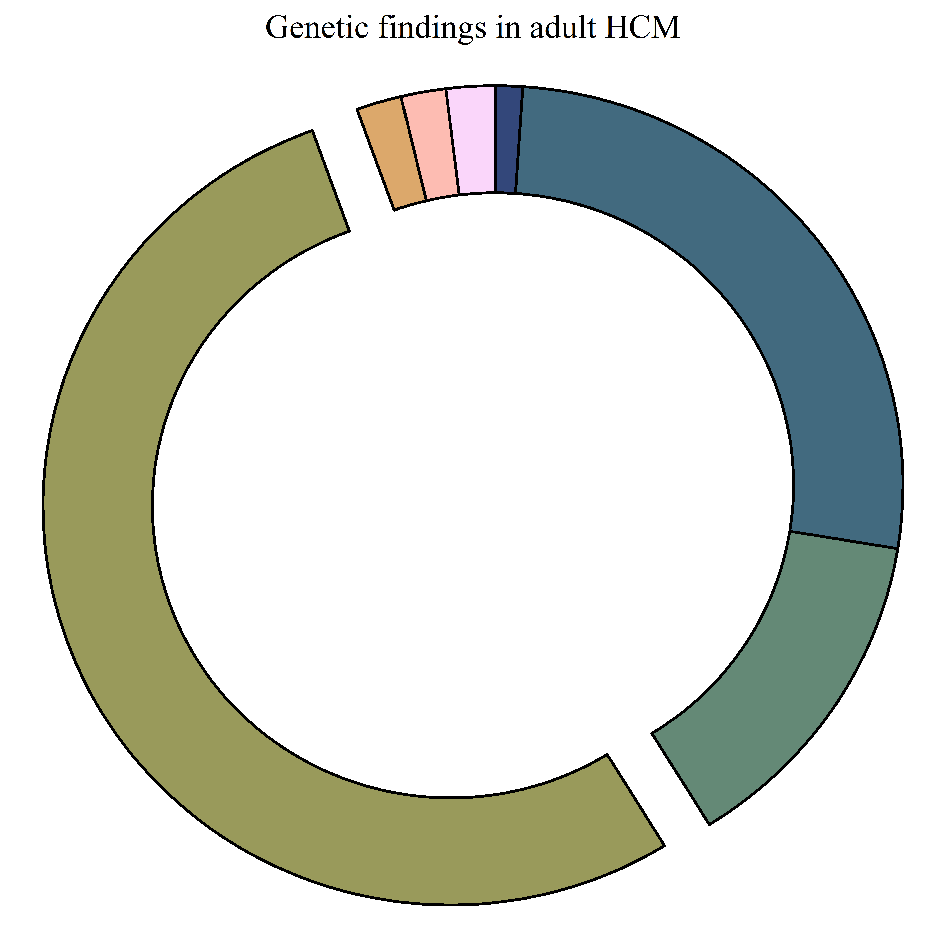
TNNI3
TNNT2
Other
Multiple variants
MYBPC3
MYBPC3
None
None
MYH7
MYH7
Childhood HCM vs adult-onset HCM

Slide 39
LVSD in children vs adults

Slide 40
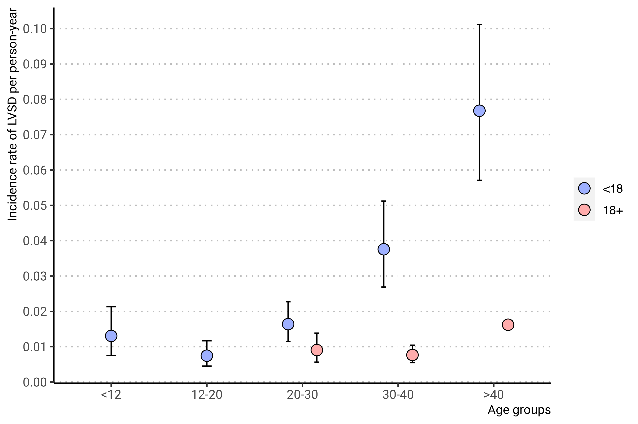
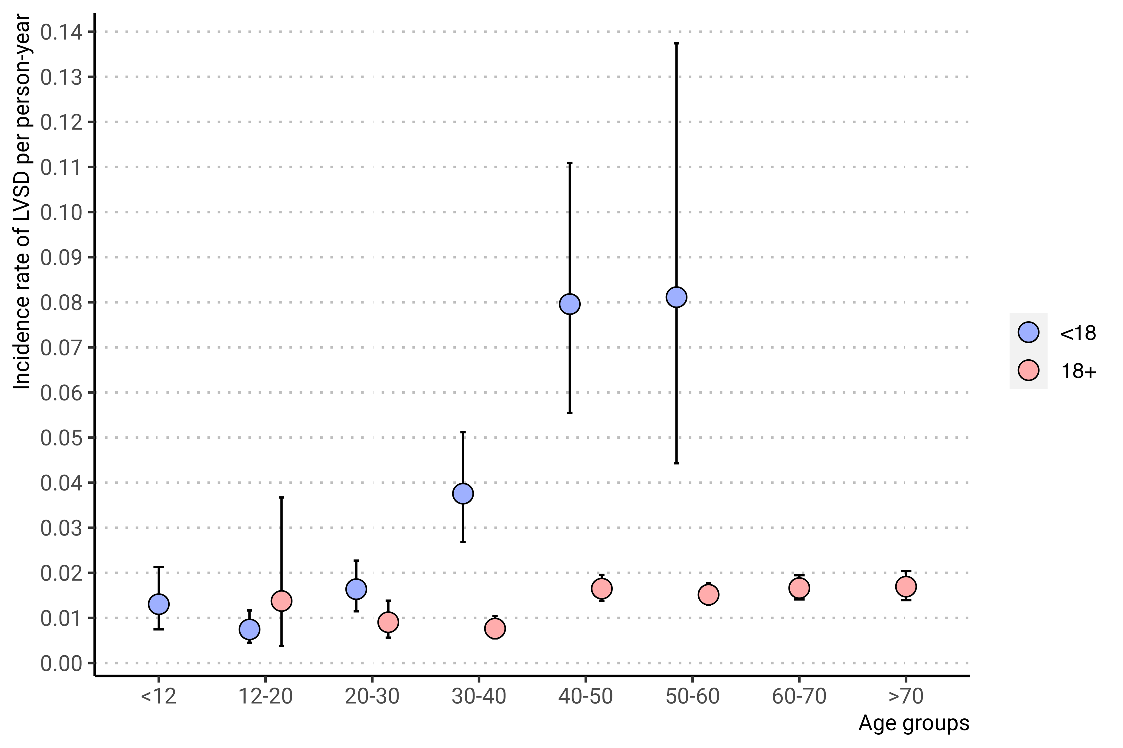
Age-specific incidence of LVSD in childhood vs adult HCM

Slide 41
Characteristics of study population
LVSD in childhood HCM
Childhood HCM vs adult-onset HCM
Outcomes

Slide 42
End-stage HCM
Associated with cardiac transplantation, VAD implantation and death
What are the rates of these HF outcomes?
Does the timing of LVSD have an influence on these outcomes?
Other important prognostic factors?
Rate of the composite outcome according to age-group and presence of LVSD

Slide 43
End-stage HCM in childhood LVSD-HCM and HF outcomes
Outcomes

Slide 44
Childhood vs adult onset of LVSD and HF outcomes
Outcomes

Slide 45
Prognostic markers of HF outcomes in childhood HCM-LVSD
Outcomes

Slide 46
Age specific incidence of the composite outcome
Composite HF in subjects with vs without LVSD
Composite HF in subjects with childhood- vs adult-onset
Composite ventricular arrhythmia in subjects with vs without LVSD
Composite ventricular arrhythmia in subjects with childhood- vs adult-onset

Slide 47
Age specific incidence of HF outcomes in childhood HCM
Outcomes

Slide 48
Age specific incidence of HF outcomes in HCM regardless of timing
Outcomes

Slide 49
Age specific incidence of HF outcomes according to age at diagnosis
Outcomes

Slide 50
Conclusion and perspective Summary
LVSD in childhood
Crude incidence rate of LVSD of 2.1% per person-year in childhood-HCM (1.5% in adult-onset)
LVSD was predicted by young age at HCM (less than 12), sex (higher in males), carrying thick filament variants or multiple LP/P, and lower baseline LVEF.
Higher LVSD incidence in children, most evident in period immediately following HCM-diagnosis, and in more advanced age-groups.
Outcomes
High incidence of composite HF outcomes in childhood-HCM-LVSD.
Composite HF occure at higher rate in females with LVSD and in subjects with severe LV dysfunction.
Events occur at high incidence in young children, suggesting a special endotype in these subjects.
Age-specific rates highlight that early phenotypic conversion signifies higher event-rates throughout life.

Slide 51


Thank you
Carolyn Ho
Thomas Roston
Sarah Abou Alaiwi
Corine Sinnette
Richard Cope
All SHaRe investigators
Mail: Christoffer.rasmus.vissing@regionh.dk
Twitter: @ulvedreng
Github: christoffervi

Slide 52
Age specific incidence of composite ventricular arrhythmia in HCM regardless of timing

Slide 53
Age specific incidence of composite ventricular arrhythmia according to age at diagnosis

Slide 54
Characteristic | <18, N = 1,104¹ | 18+, N = 7,236¹ | p-value²
Female sex | 393 (36%) | 2,894 (40%) | 0.005
Age at HCM diagnosis, yrs | 12.6 (7.3 to 15.3) | 49.6 (37.3 to 60.6) | <0.001
LVSD at first SHaRe visit | 65 (6.4%) | 241 (3.6%) | <0.001
Total follow-up, yrs | 5.1 (2.0 to 9.6) | 4.3 (1.3 to 9.0) | <0.001
Proband | 968 (88%) | 6,475 (91%) | 0.006
Genetic status |  |  | <0.001
LP/P | 451 (64%) | 2,154 (44%)
VUS | 87 (12%) | 481 (9.8%)
Genonegative | 172 (24%) | 2,260 (46%)
Unknown | 394 | 2,341
Gene with class IV-V variants
MYH7 | 197 (28%) | 570 (12%)
MYBPC3 | 177 (25%) | 1,312 (27%)
TNNT2 | 27 (3.8%) | 85 (1.7%)
TNNI3 | 18 (2.5%) | 84 (1.7%)
TPM1 | 7 (1.0%) | 25 (0.5%)
ACTC1 | 5 (0.7%) | 5 (0.1%)
MYL2 | 5 (0.7%) | 25 (0.5%)
MYL3 | 2 (0.3%) | 4 (<0.1%)
multiple variants | 14 (2.0%) | 47 (1.0%)
none | 259 (36%) | 2,741 (56%)
Unknown | 392 | 2,317
Max LV wall thickness, mm | 16.0 (12.0 to 23.0) | 17.0 (14.0 to 21.0) | <0.001
LV ejection fraction at first echocardiography, % | 64.9 ± 10.8 | 65.0 ± 9.0 | 0.2
LVEF af LVSD, % | 43 (35, 47) | 42 (35, 46) | 0.7
LA dimensions, mm | 35.7 ± 11.2 | 40.7 ± 10.5 | <0.001
Unknown | 295 | 854
Left ventricular outflow tract obstruction, (lvot gradient >30 mmHg) | 151 (25%) | 2,434 (41%) | <0.001
Unknown | 491 | 1,233
Left ventricular outflow tract obstruction, (event 30) | 314 (45%) | 2,962 (49%) | 0.019
Unknown | 400 | 1,223
lvsd_timing1 |  |  | <0.001
No LVSD | 956 (87%) | 6,642 (92%)
LVSD at first SHaRe visit | 59 (5.3%) | 221 (3.1%)
Incident LVSD | 89 (8.1%) | 373 (5.2%)
¹n (%); Median (25% to 75%); Mean ± SD; Median (IQR) | 1 | 1 | 1
²Pearson's Chi-squared test; Wilcoxon rank sum test | 2 | 2 | 2

